Slide 1
Multi Drug resistance classification using Machine Learning
Sachin Kakkookal
Student (REVA University)

Slide 2
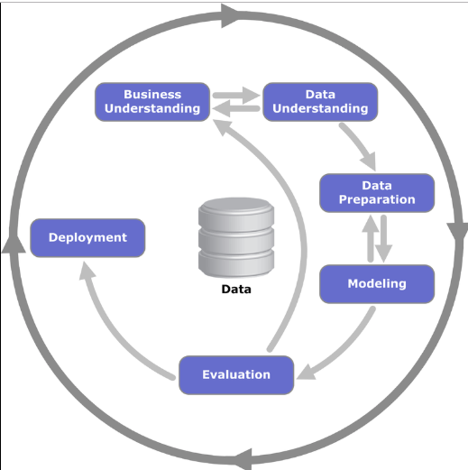
CRISP-DM METHODOLOGY

Slide 3
OBJECTIVE
1.To profile the Multi drug resistant cohort
2.To identify the important facts of the MDR profiles
3.To predict the case when only non lab information is available

Slide 4
BUSINESS UNDERSTANDING
Multidrug-resistant TB (MDR-TB) : is a form of TB caused by organisms that are resistant to at least the two most effective anti-TB drugs, isoniazid & rifampicin.
These forms of TB do not respond to the standard six month treatment with first-line anti-TB drugs and can take two years or more to treat with drugs that are less effective, more toxic and more expensive.
About 3.6 % of New Tuberculosis patients in the world have multi drug resistant strains (MDR – TB)
About 20% of previously treated patients of Tuber culosis have MDR - TB

Slide 5
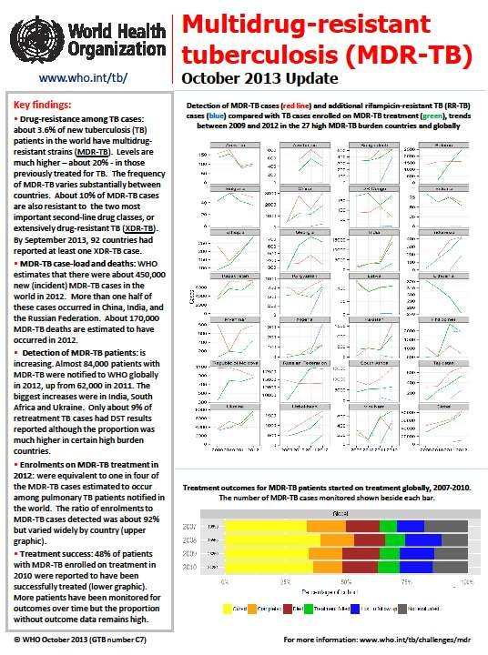

Slide 6
INDIAN SCENARIO (MDR –TB)
2.2% OF NEWLY DIAGNOSED TB CASES ARE MDR-TB CASES
15 % OF PREVIOUSLY TREATED TB CASES ARE MDR- TB CASES
Total Cases tested for MDR-TB 55 611
Laboratory-confirmed MDR-TB cases 16 588
Patients started on MDR-TB treatment 14 143

Slide 7
GENERAL CAUSES OF MDR-TB
MULTIPLE INEFFECTIVE T B REGIMENS
DELAYED DIAGNOSIS
WRONG DOSE
NON COMPLIANCE
WRONG DURATION OF TREATMENT
POOR QUALITY OF DRUGS

Slide 8
MDR TB SUSPECT CRITERIA
MDR Suspect Criteria
Criteria A –
All failures of new TB cases
Smear +ve previously treated cases who remain smear +ve at 4th month onwards
All pulmonary TB cases who are contacts of known MDR TB case
Criteria B – in addition to Criteria A:
All smear +ve previously treated pulmonary TB cases at diagnosis
Any smear +ve follow up result in new or previously treated cases
Criteria C – in addition to Criteria B
All smear -ve previously treated pulmonary TB cases at diagnosis,
HIV TB co-infected cases at diagnosis

Slide 9
DIAGNOSTICS
Currently 3 technologies are available for diagnosis of MDR TB viz.
The conventional solid egg-based lowenstein- jensen (LJ) media
The liquid culture (MGIT),
The rapid molecular assays such as line probe assay (LPA) and similar nucleic acid Amplification Tests like Xpert MTB/Rif.

Slide 10
Benefits of Research
Enables the Lab technicians to identify multi drug resistant patients quickly
Cost savings in detecting multi drug resistance
Time savings in identifying MDR-TB patients
To promote research that will lead to quicker way of identifying MDR-TB and bring down the number of MDR-TB affected patients

Slide 11
Research Methodology
Data understanding
Data Preparation
Analysis & Modelling – Classification models, Mapping
Evaluation and Results
Conclusion

Slide 12
DATA UNDERSTANDING
Data was collected on real time through PAN INDIA survey over several years.
The data consists of the patient medical history, drug sensitivity results , demographic details and lab test results
There are 5280 observations which forms the raw data .

Slide 13
Data description
City status : Strata the patients belong to ( Rural/Urban/Tribal)
Smoke status – Non smoker/Past-smoker/Current Smoker
Drink status – Non–alcoholic /Current alcoholic /Past-alcoholic
TB Contact - History of TB patients in the family
HIV status – Diagnosed with HIV or not
Diabetes – Diabetic /Non-diabetic
Marital – Married/UnMarried/Widow/Separated/Divorced
Education – College/Illiterate/Primary School/High School

Slide 14
DATA PREPARATION
Patients were separated into two segments
a) Patients who are treated for the first time
b) Patients who are previously treated
Fresh cases vs Previously treated cases
a) Number of fresh cases = 3015
b) Number of previously treated cases = 1877
Out of 5280 records , 323 records did not have drug susceptibility test results . Hence they were discarded

Slide 15
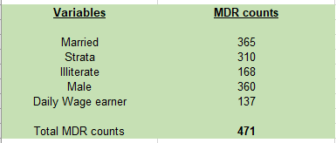
Exploring the Data
Initial exploratory analysis on the previously treated cases showed the following variables significant
a) Marital
b) Strata
c) Education
d) Gender
e) Job Type

Slide 16
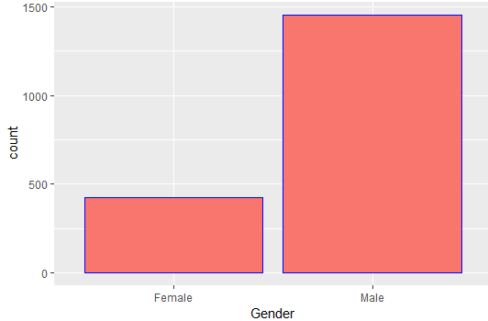
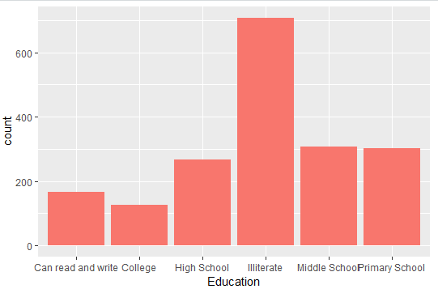
Distribution of key variables

Slide 17
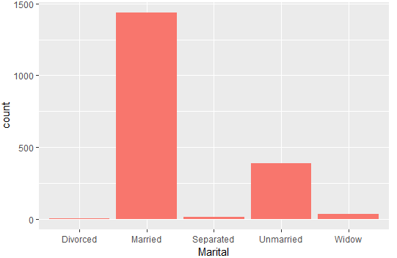
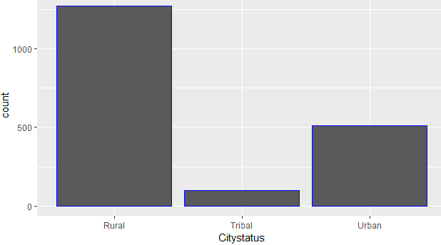

Slide 18
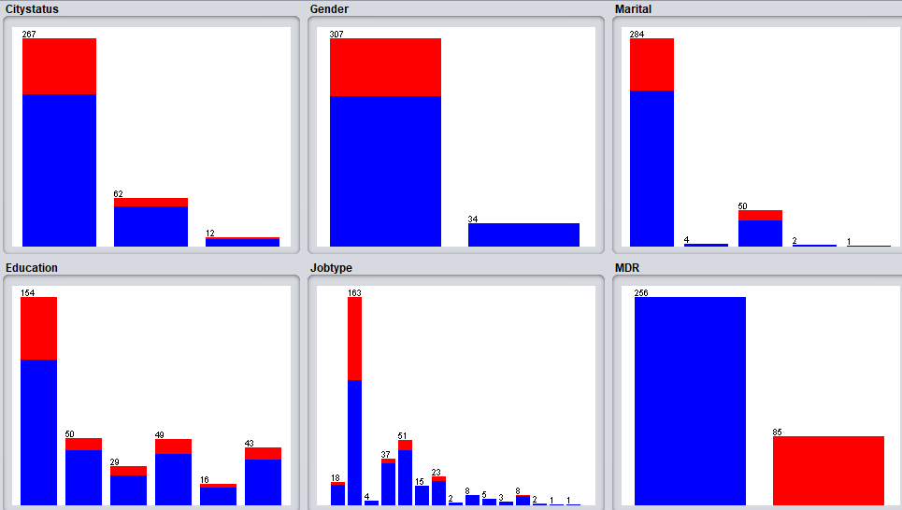

Distribution of MDR cases

Slide 19
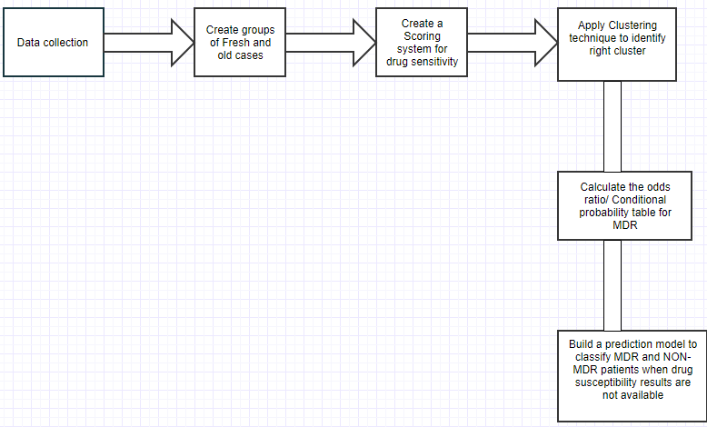
ANALYSIS & MODELLING

Slide 20
ANALYSIS & MODELLING(Cont..)
One of the most popular clustering technique – Simplekmeans is used for the analysis . The idea is to identify a segment which represents a large chunk of the MDR population
Each patient was assigned a score based on the resistance they had against 13 drugs (fluoroquinolones) including Rifampicin and Isoniazid (I&H)
Patients who were resistant to Rifampicin or Isoniazid were marked as MDR
Patients who were resistant to other drugs were also included in the scoring system

Slide 21
ANALYSIS & MODELLING(Cont..)
After identifying the right cluster , further analysis was carried out .
We derived the conditional probability matrix using Naives Bayes technique to identify the significant variables that are affecting multi drug resistance
A machine learning model was built to predict the MDR cases without drug susceptibility tests
Several classifiers such as Random Forests , Support Vector machines were used to refine the accuracy of the model

Slide 22
EVALUATION & RESULTS
There were 235 patients who were resistant only to Rifampicin and Isoniazid
There were 236 patients who were resistant to several drugs including Rifampicin and Isoniazid
172 patients were resistant to other drugs except Rifampicin and Isoniazid

Slide 23
Evaluation and Results (Cont)
Using SimpleKmeans , We discovered that 54% of the MDR cases were coming from 18% of the previously treated cases . ie , 256 MDR patients from 341 observations
We can also infer that 54% of the total MDR population is coming from 7% of the total population ( 5280 records)
Gender , Strata , Education , Smoking , Drinking , resistance to other drugs were identified as the variables of interest

Slide 24
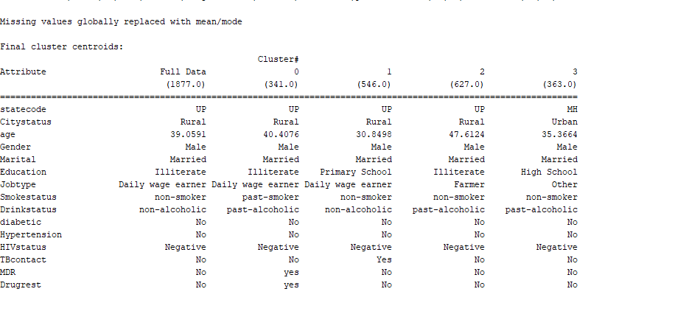

Evaluation and Results (Cont..)

Slide 25
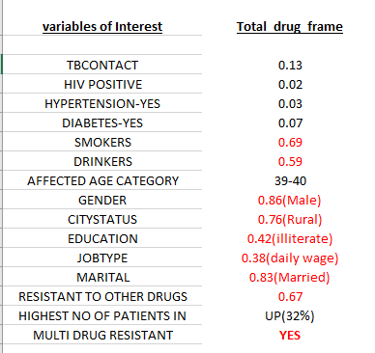
Evaluation and Results (Cont)
After computing the conditional probability table , the following
insights were recorded .A multi drug resistant patient has
a) 69% chances of being an Smoker
b) 59% chances of being an alcoholic
c)86% chances of being a Male
d) 76% chances of living in Rural strata
e) 86% chances of being Married
f) mostly falling into age category of 39 – 41
g) High chances of coming from Uttar Pradesh

Slide 26
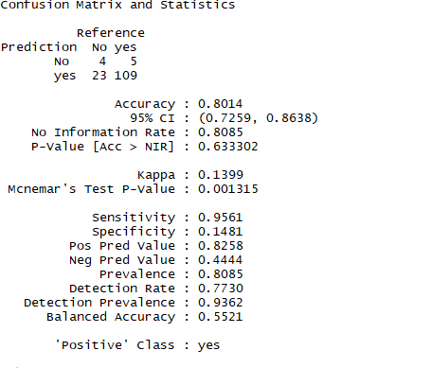
Evaluation and Results (Cont)
Out of several machine learning classifiers , Random Forest was able to predict the MDR positive cases with a recall of 95.6%

Slide 27
CONCLUSION
We conclude that the insights derived from this work should be used in real time to identify the Multi drug resistance in laboratories as it can significantly bring down the cost of drug susceptibility tests and the time taken to start the treatment for Multi drug resistant patients
This project can open a wide range of possibilities to promote the research in identifying multi drug resistance TB using machine learning

Slide 28
Thank You !!

